Slide 1
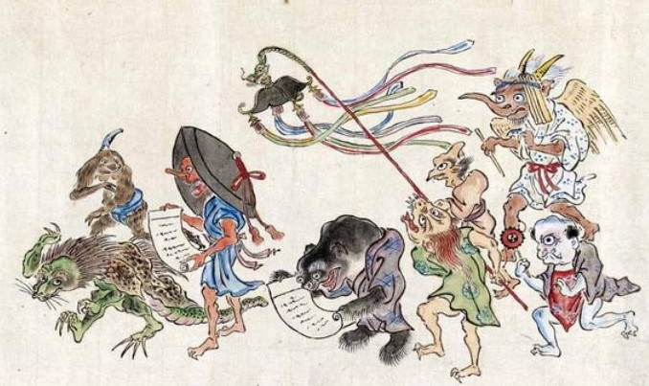
Reading sources effectively (I).
Asia Enchanted: 01.31.22

Slide 2
Questions about the syllabus?
Post them to the “Syllabus” discussion board in Canvas now, or post that you don’t have any questions. This is how you earn credit for today’s class.

Slide 3
Reading effectively: seeing what’s there.
We’ll look at the books under the document camera to see what information they provide. Places to look include the front and back covers, the front matter and the appendices, and any headings within the assigned sections.

Slide 4
Prompt and rubric for Paper 1: knowing your source.
Introduce an online, English-language source about an East Asian, South Asian, or Southeast Asian god, ghost, or monster. 250 words total, plus or minus about 10%.

Slide 5

Allowed sources:
Books and book-chapters.
Single-author.
Multi-author.
Edited.
Translated.
Periodicals.
Journal articles.
Magazine articles.
Newspaper articles.
Websites & blogs.

Slide 6
Paper 1: required steps.
1
Turn in topic by 8pm, Tuesday, February 8 (working link).
Your topic is your SOURCE, not the god, ghost, or monster.
2
Turn in draft of paper by 8pm, Thursday, February 10 (file upload).
You must turn in something to be assigned peer reviews.
3
Finish peer reviews by 8pm, Sunday, February 13 (in-Canvas tool).
Use the rose-bud-thorn format. I will discuss this next week.
4
Turn in revision of paper by 8pm, Thursday, February 17 (file upload).
This is the point at which we score the paper, using the rubric.

Slide 7
Detailed prompt. Remember, this paper is about the source, not the creature.
Give a Chicago-style bibliographic entry (author and date system) for the source, using the examples give in pages 5 and 6 of this model: https://ebookcentral.proquest.com/lib/wisc/reader.action?docID=4877146
Introduce the source:
State the kind of source and summarize its content (90-110 words, give word count).
Explain the source’s value for someone unfamiliar with the god, ghost, or monster in question (70-80 words, give word count). What is it good for? Why do you say that?
Explain the source’s limitations for someone unfamiliar with this god, ghost, or monster (70-80 words, give word count). What is this source not good for? What makes you say that?

Slide 8
Scoring rubric. Remember, the paper is about the source, not the creature.
Is the bibliographic entry accurate and in the appropriate style from the model in the prompt (author-date as shown in that exact website)?
Does the paper accurately identify the source and summarize the content at the right length? Do you give the wordcount for this part?
Does the paper clearly and persuasively explain the source’s value for someone unfamiliar with the topic? Is this section the right length? Do you give the wordcount for this part?
Does the paper clearly and persuasively explain the source’s limitations for someone unfamiliar with the topic? Is this section the right length? Do you give the wordcount for this part?

Slide 9
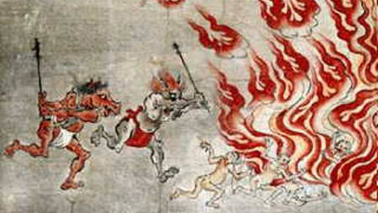
Example: a source on horse-headed demons.
I found this by searching “horse-headed demon” in Google.

Slide 10
Wikipedia. 2021. “Ox-Head and Horse-Face.” Last modified December 23. https://en.wikipedia.org/wiki/Ox-Head_and_Horse-Face.
This source is a Wikipedia page about two creatures called Ox-Head and Horse-Face. The page briefly introduces the creatures’ Chinese names and their roles in Chinese and Japanese mythology. It also presents pictures of statues and paintings of the creatures from Singapore, Taiwan, and China as well as a scroll in the Seattle Asian Art Museum. The page links to twelve other pages on topics from Western and Chinese mythology. It lists two references, a 2014 English-language encyclopedia of demons and a 2004 French-language work about Japan. The bottom of the page asks for help in expanding it and names seven categories into which these creatures fit. (107 words)

Slide 11
Next time: the rest of the example & more reading tips.
I will start the next class with questions about the prompt. Does anyone have OTHER questions for me right now?

